Slide 1
Birthday Hoax Originating From A Simple Tweet
Presented By: Matthew Stevenson
Course: CS895, Date: 2019-04-3

Slide 2
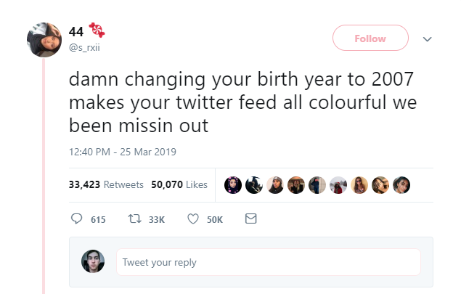
Most Popular Tweet
https://twitter.com/s_rxii/status/1110265095702097920

Slide 3
Another Tweet
https://twitter.com/ThereJohnnyGo/status/1110670786845655040

Slide 4
Earliest Found Tweet Based On Twitter Advanced Search
Original Tweet?
https://twitter.com/edouxrd/status/1109890764253863937

Slide 5
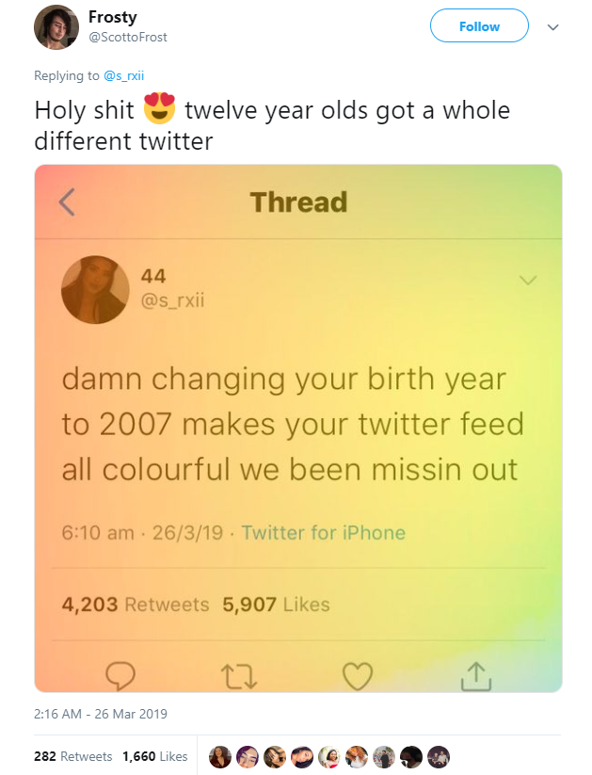
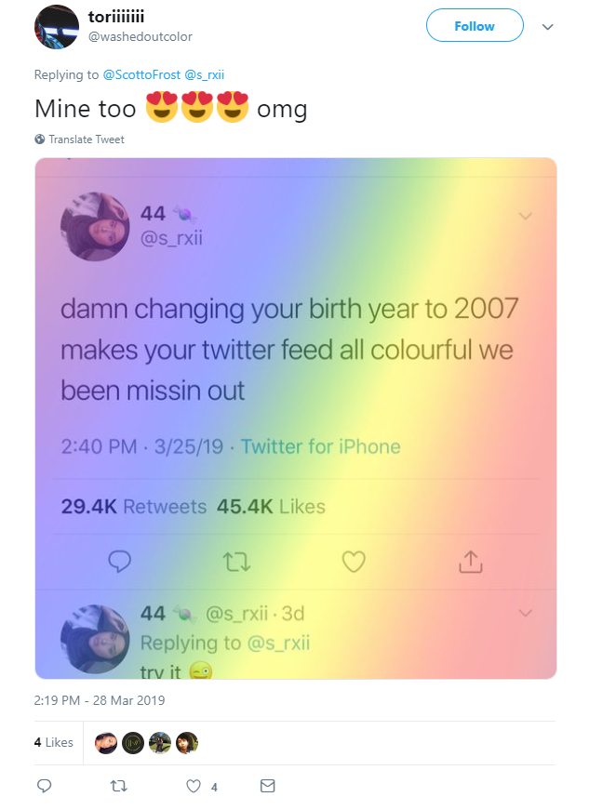
Responses To Popular Tweet
Reply In Thread To @ScottoFrost
https://twitter.com/ScottoFrost/status/1110470509446090752

Slide 6
That Seems Quite Convincing…
Who Doesn’t Enjoy New Themes

Slide 7
Did Users Themes Actually Change?
Let’s Have A Look

Slide 8
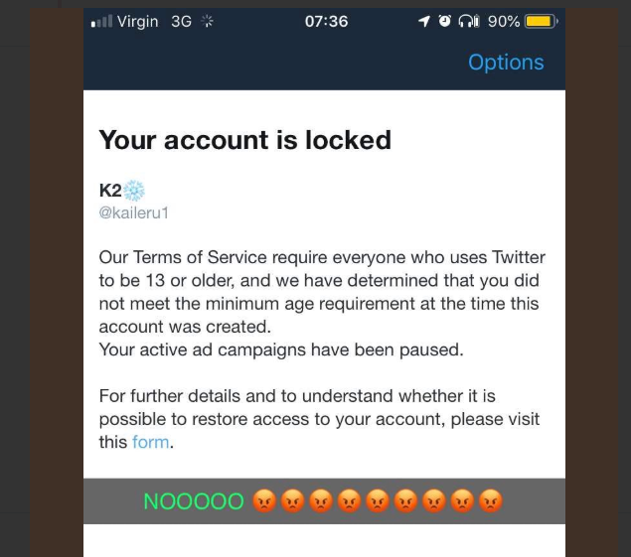
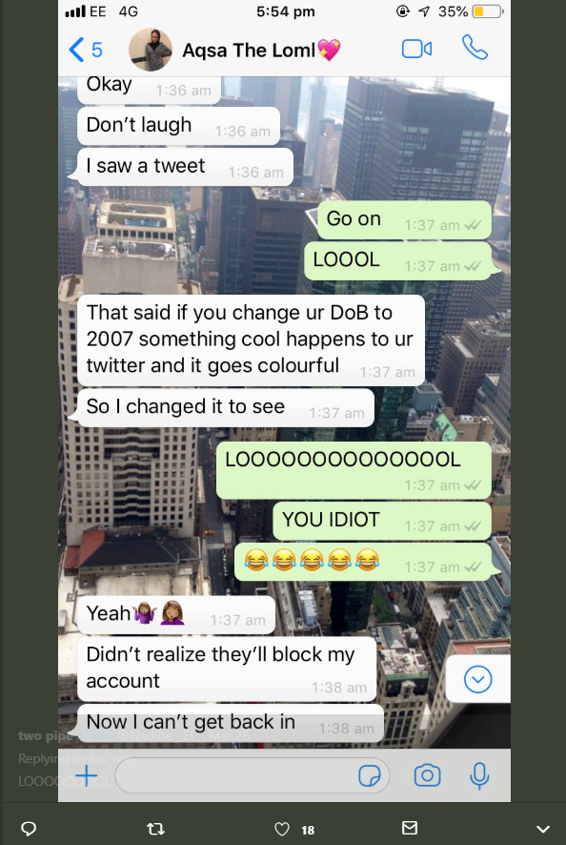
User Responses
https://twitter.com/s_rxii/status/1110265095702097920
https://twitter.com/s_rxii/status/1110265095702097920

Slide 9
Reactions To Users Misfortunes
https://twitter.com/edouxrd/status/1109890764253863937

Slide 10
Thinking about it
There is no conversation found between these accounts other than the direct replies in the into tweet thread
One can only assume the true nature of these replies
However, taking into account the earliest tweet from @edoudrxd and others, it appears the tweets are meant to be taken as a joke, but quickly turned into users falling for a trap they had introduced to the Twitter community

Slide 11
Twitter Must Have A Response
Let’s See What They Say

Slide 12
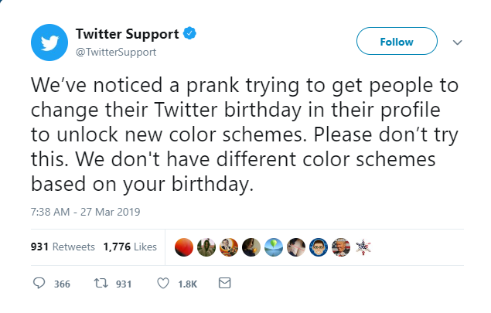
Twitter Response
https://twitter.com/TwitterSupport/status/1110913960230948864

Slide 13
How Did This Happen?
There Must Be A Reasonable Explanation

Slide 14
The Twitter Age Requirement Enforcement
What Does The Policy State?

Slide 15
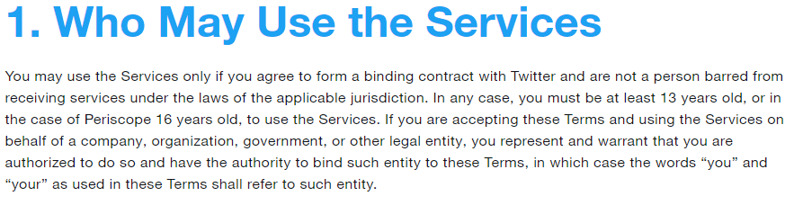
Twitter Terms Of Service
https://twitter.com/en/tos

Slide 16
Why Did Twitter Decide To Begin Enforcing Age Requirements?
Let’s Have A Look

Slide 17
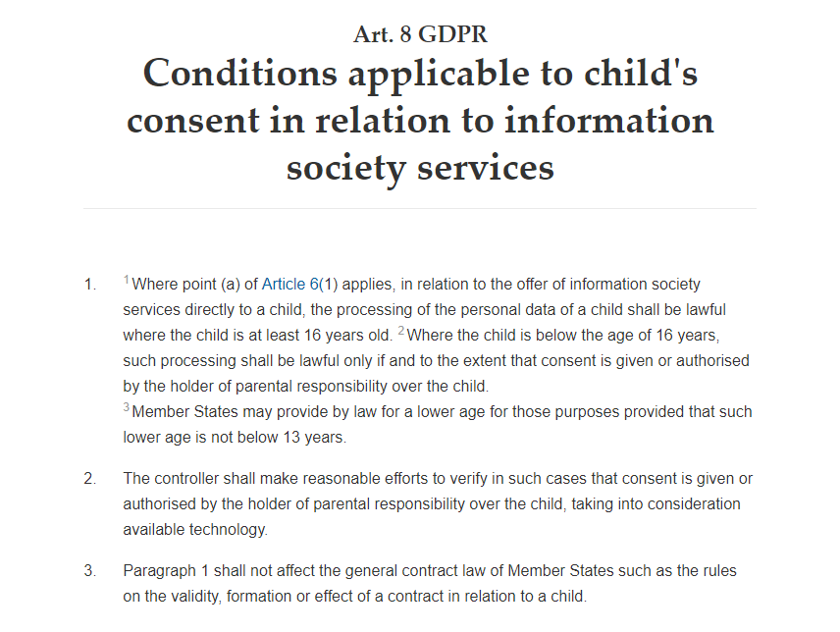
Twitter Enforces Terms Of Service On Age Restriction
https://gdpr-info.eu/art-8-gdpr/

Slide 18
Did Twitter Users Have Problems When The Policy Was First Enacted?
It Turns Out Twitter Caused A Bunch Of Problems

Slide 19
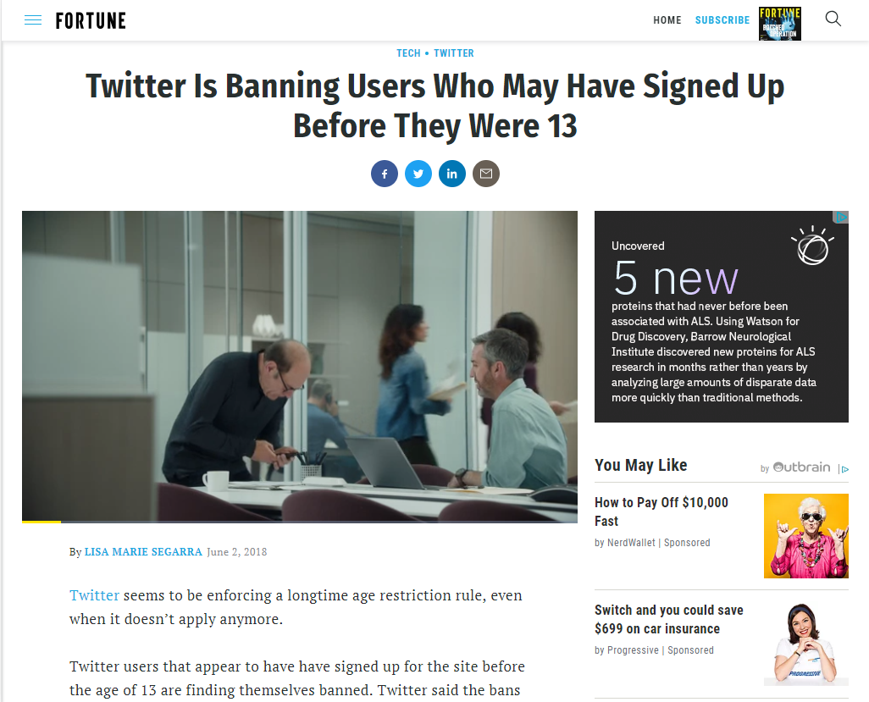
Twitter Enforces Terms Of Service Based On Age Restriction
http://fortune.com/2018/06/02/twitter-banning-users-13/

Slide 20
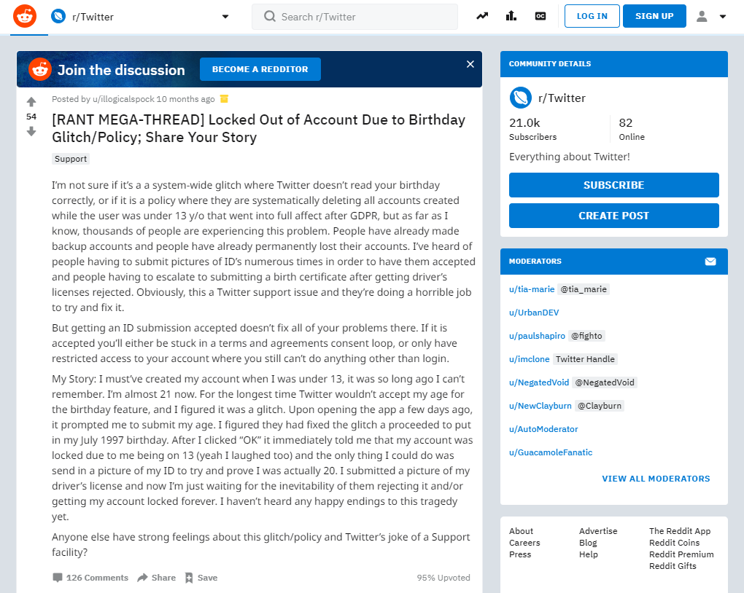
Twitter Age Enforcement Causes An Unexpected Glitch
https://www.reddit.com/r/Twitter/comments/8mzd4i/rant_megathread_locked_out_of_account_due_to/

Slide 21
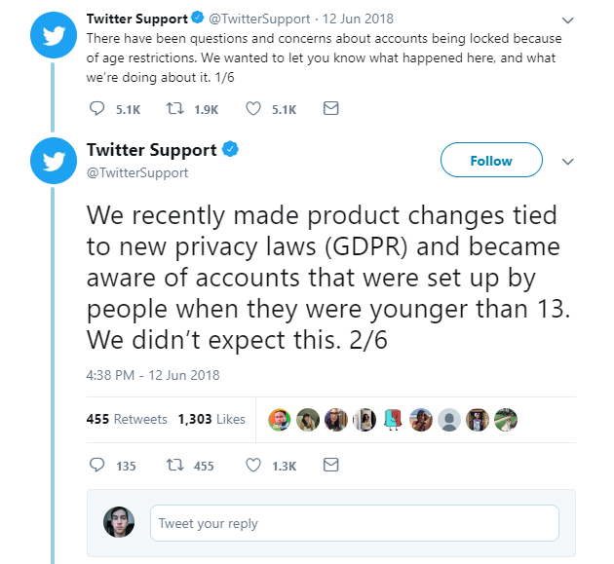
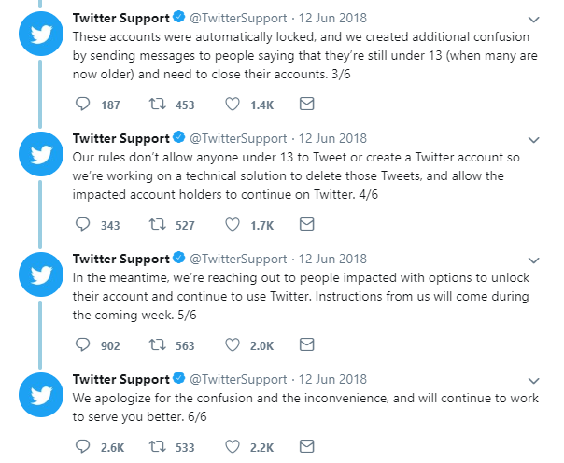
Twitter Responds
https://twitter.com/TwitterSupport/status/1006682102513848320

Slide 22
Twitter Enforcement Mishap
In many cases, Twitter algorithms mistakenly locked users out of their account even though they were above 13 years old requirement
This was based on the entered information for the birthdate from when a user’s account was first created
Meaning: The user signed up underage, but is now of age.

Slide 23
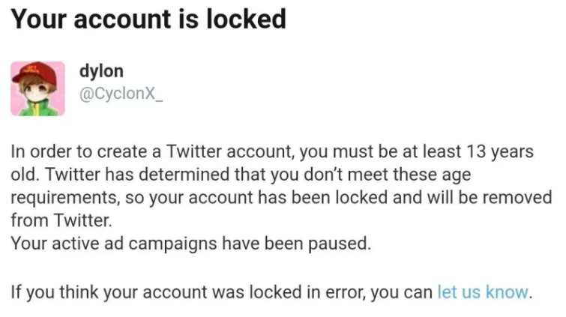
A Message From Twitter
https://twitter.com/TwitterSupport/status/1006682102513848320

Slide 24
So What Did Twitter Offering Its Users To Reclaim Their Accounts?
Let’s Have A Look

Slide 25
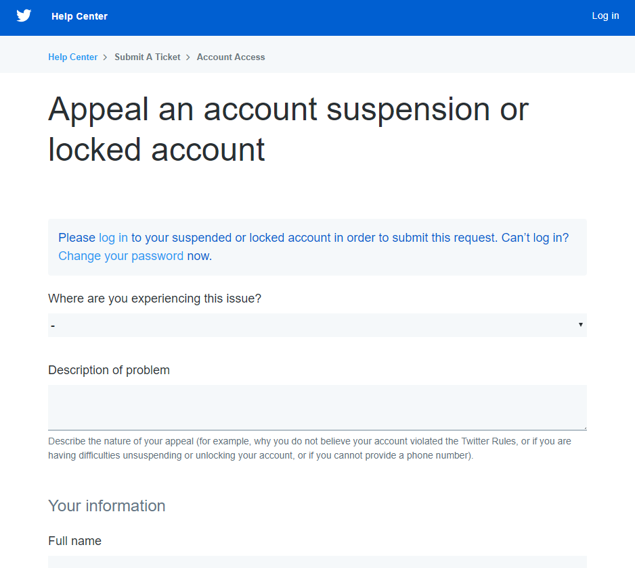
Twitter Account Appeal
https://help.twitter.com/forms/general?subtopic=suspended

Slide 26
Account Restoration
Requires proof of age
if user is under the age of 18, the user must provide parental consent including parental identification alongside with initial appeal

Slide 27
Now Back To The Birthday Hoax
What Is Twitter Offering Its Users?

Slide 28
Twitter Account Appeal
https://help.twitter.com/forms/general?subtopic=suspended

Slide 29
The Age Enforcement Began In Mid-2018
One Would Think Users Would Be Aware Of The Dangers Of Changing Their Age

Slide 30
The Hoax Was Successful Based On The Criteria
Twitter users wanted new themes
Influence was strong based on widespread social media interaction
Users affected by hoax were unaware of Twitter’s age enforcement policy that took place last year
Dynamics of human behavior while on social media exploited
Psychological factors of users wanting to receive satisfaction based on interacting with trending content was also exploited
Originator of birthday hoax is unknown however the earliest is tweet is from the account @edoudrxd

